Slide 1
Life Expectancy Analysis Analysis Machine Learning Project ( Data Analyst)
Life Expectancy Analysis using Data Visualization & Machine Learning Domain: Healthcare Analytics / Data Analyst Project Tools: Python, Machine Learning, Plotly, Scikit-learn Prepared by: Gayatri Raghunath Kulkarni
UNID: UMID05112569400

Slide 2
Project Overview
This project focuses on analyzing the key factors affecting life expectancy across countries from 2000–2015. Using WHO global health data, we explore relationships between:
Mortality rates
Immunization coverage
GDP and expenditure
Education and social factors
Goal: Build predictive models for life expectancy.

Slide 3
Dataset Description
Dataset Source: WHO Global Health Observatory ,Countries Covered: 193 Time Period: 2000–2015
Dataset Size:
Rows: 2938
Columns: 22
Target Variable: Life Expectancy
Key Features:
Adult Mortality
Infant Deaths
GDP
Schooling
Alcohol Consumption
Immunization Rates

Slide 4
Problem Statement
The project aims to answer:
What factors influence life expectancy the most?
Do GDP and schooling improve lifespan?
How do mortality rates reduce life expectancy?
Which ML model gives the best prediction accuracy?

Slide 5
Data Preprocessing
Steps performed:
Checked missing values in Alcohol, GDP, Population, Schooling
Imputed missing values using Mean Strategy
Removed duplicates
Prepared dataset for analysis
Outcome: Clean dataset ready for modeling.

Slide 6
Outlier Detection & Treatment
Outliers were identified using Boxplots. Handled using the IQR Method:
Values outside lower/upper bounds replaced with mean
This improved data stability and model performance.

Slide 7
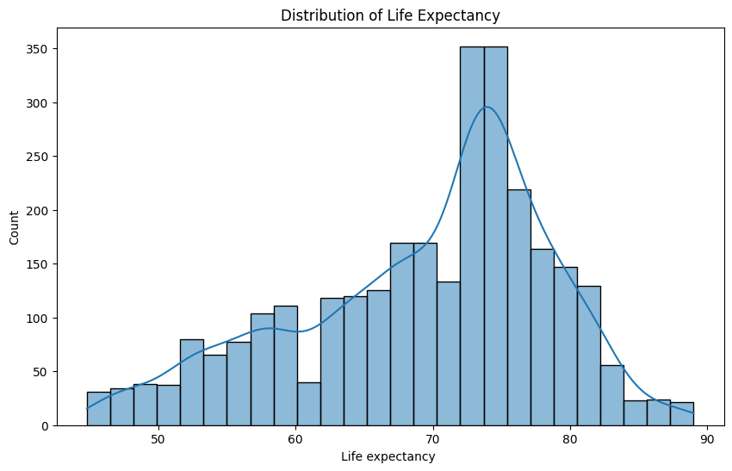
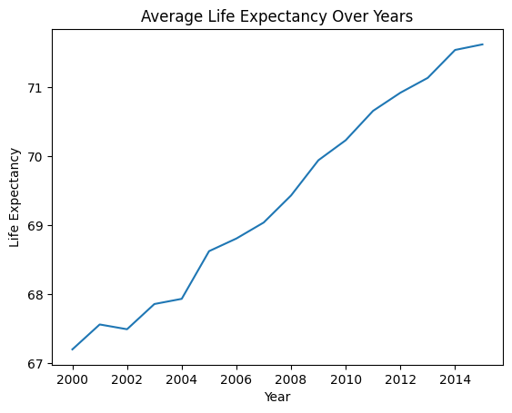
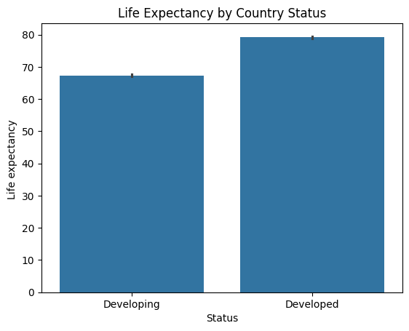
Exploratory Data Analysis (EDA)
Key visualizations included:
Distribution of Life Expectancy
Trend of average life expectancy over years
Developed vs Developing country comparison
Population vs Life Expectancy scatter plots
Insight: Life expectancy increased globally from 2000–2015.

Slide 8
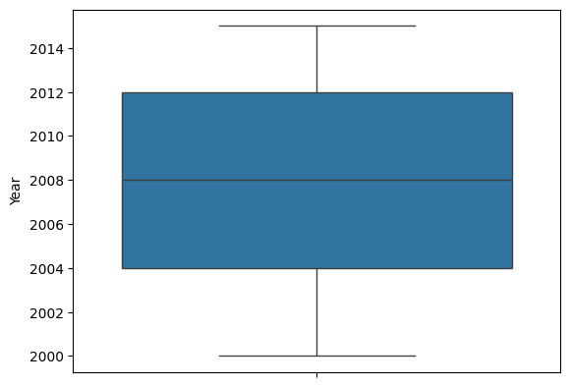
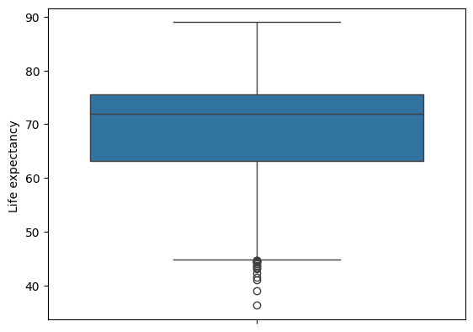
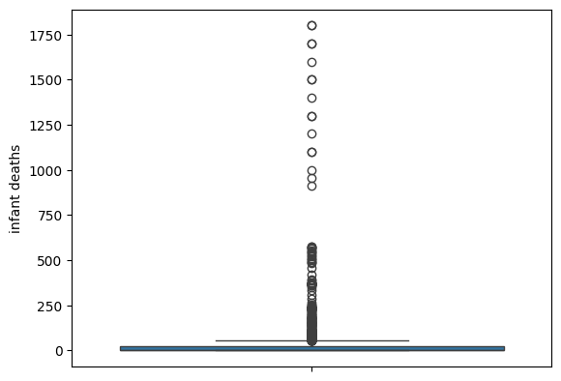
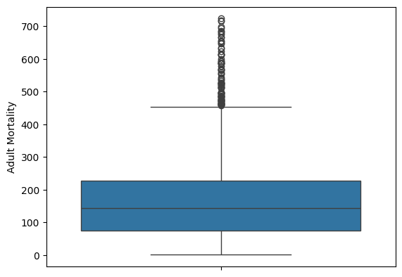

Slide 9
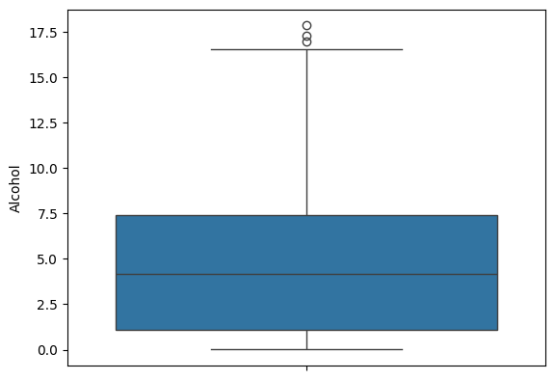
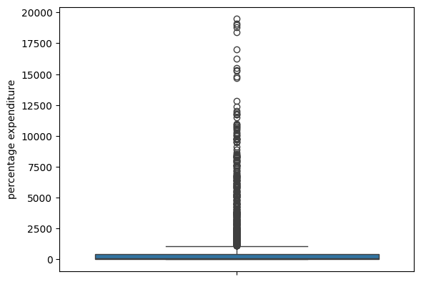
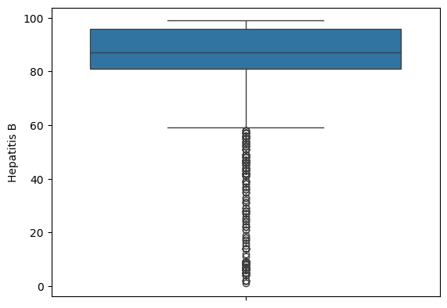
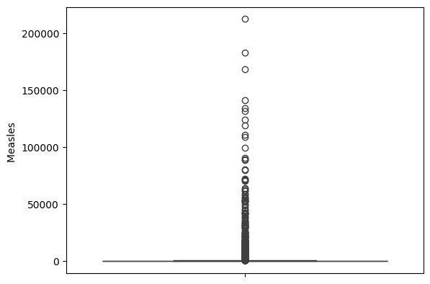

Slide 10
Correlation Analysis
A heatmap was used to study relationships:
Strong Positive Correlation:
Schooling ↑ → Life Expectancy ↑
GDP ↑ → Life Expectancy ↑
Strong Negative Correlation:
Adult Mortality ↑ → Life Expectancy ↓
HIV/AIDS ↑ → Life Expectancy ↓

Slide 11
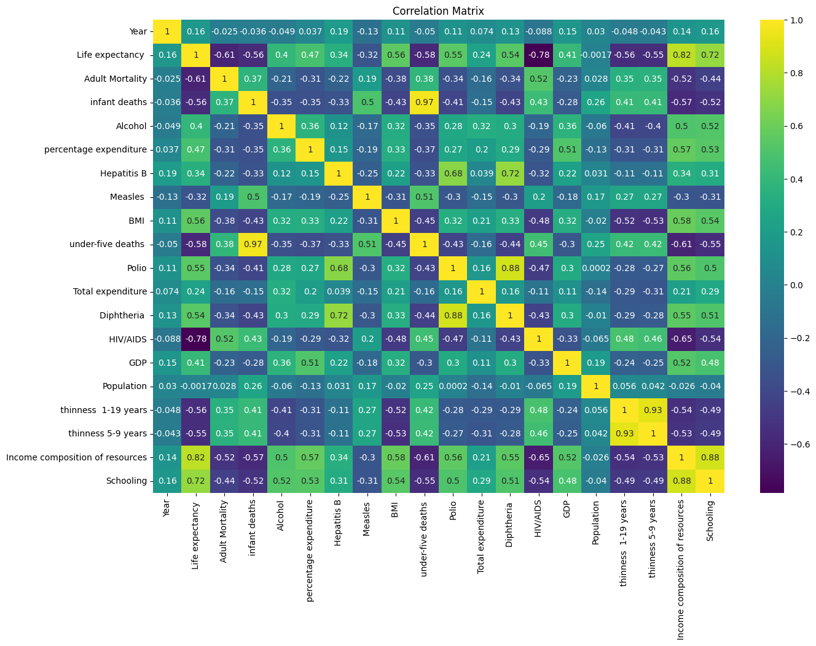

Slide 12
Feature Engineering & Scaling
Preprocessing before ML:
Encoded categorical variable: Status
Applied StandardScaler for normalization
Split dataset into Train (80%) and Test (20%)
Prepared final feature matrix for prediction.

Slide 13
Machine Learning Models Used
Multiple regression models were trained:
Random Forest Regressor
Extra Trees Regressor
Gradient Boosting Regressor
XGBoost Regressor
Evaluation Metrics:
R² Score
RMSE (Error)

Slide 14
Model Comparison Results
Best performing model:
XGBoost Regressor
R² Score: ~0.959
RMSE: ~1.98
Model accuracy achieved: 96%
Cross-validation confirmed stable performance.

Slide 15
Conclusion & Key Findings
Project Conclusions:
Education and GDP strongly improve lifespan
Adult mortality is the biggest negative factor
Developed countries have higher life expectancy
XGBoost provides the best prediction performance
Future Enhancements:
Deploy as dashboard (Streamlit/PowerBI)
Add deep learning regression models
Forecast life expectancy for future years

